Slide 1



CSharp Super stack Creating highly scalable Neo4j web apps without JavaScript
Michael Herman Hyperonomy Digital Identity Lab Parallelspace Corporation Alberta, CANADA
mwherman@parallelspace.net

Slide 2
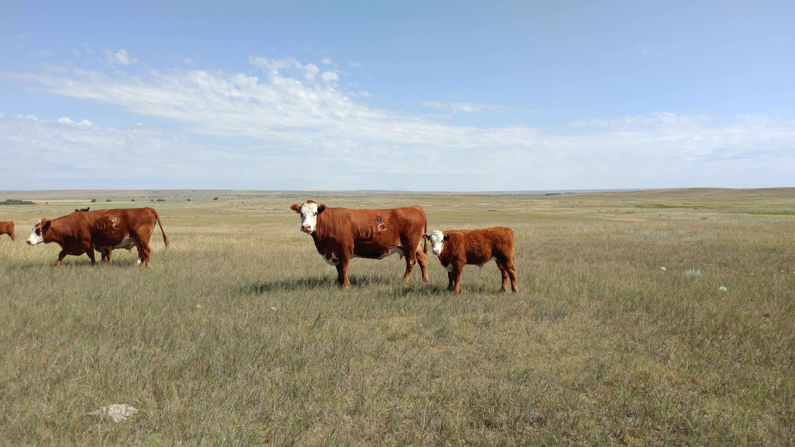
Michael Herman Solution Architect, and Developer Hyperonomy Digital Identity Lab Parallelspace Corporation Alberta, CANADA
RFID
R
C
Left Rib
It’s all about relationships
(m:cow)-[r:mother]-(calf:cow)
Ranchville Cattle Company
SW 34-20-2W4
Box 45, Bindloss, Alberta
2

Slide 3
My Neo4J Experience
4+ years of hands-on Neo4j solution development
Blog http://www.hyperonomy.com?s=neo4j
#Graphitization of ArchiMate: Getting MMOR from ArchiMate using the ModelMate Master Online Repository
Crossing the EA Chasm: #Graphitization of ArchiMate 3.0 – Iteration 2
#Graphitization of Ray Dalio’s Principles: Iteration 1
#Graphitization of Ray Dalio’s Principles: Iteration 2
Crossing the EA Chasm: ArchiMate “Keep Calm and Have IT Your Way”
Crossing the EA Chasm: Automating Enterprise Architecture Modeling #1
Crossing the EA Chasm: Automating Enterprise Architecture Modeling #2
#Graphitization of .NET Applications: Marrying Open EA Data with Graph Databases

Slide 4
CSharp Super Stack (CSSS)
Definition
Application framework for creating highly scalable Neo4j web apps without JavaScript
Based on the Blazor OSS project
Blazor Server App hosting model
Solution stack: C#, HTML and CSS
Solution stack: Cypher and Neo4j .NET Driver

Slide 5

SINGULAR Goal
Making Neo4j web application development easier for C# and .NET developers

Slide 6
Agenda
Blazor Web Application Framework
Neo4j Graph Database Server
Neo4j .NET Integration
CSharp Super Stack (CSSS)
Final Notes
Q&A

Slide 7
 Blazor Web Application Framework

Slide 8
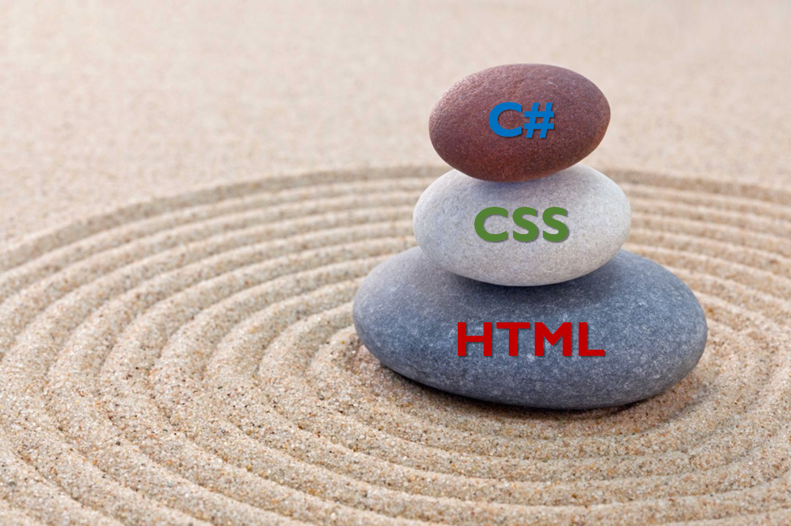
Blazor OSS project
Based on the Reusable UI component programming model
Micro Frontend / Vertical Slice Architecture
Powerful, uncomplicated technology foundation
Pure C#, CSS and HTML
JavaScript interop supported when needed
Two interchangeable hosting models
Blazor WebAssembly (WASM) App: In the browser
Blazor Server App: Server-based web application
Production release as part of .NET 3 & .NET 5
“Feature” of ASP.NET Core (product ownership)

Slide 9
Blazor Stack
Blazor Server Hosting Model
Blazor WASM Hosting Model (Browser)
.NET SERVER RUNTIME
.NET WASM
(mono.wasm)
RUNTIME
BLAZOR Components to IR to C# to .NET ASSEMBLIES (MSIL)
RAZOR PAGE MODEL
BLAZOR COMPONENT MODEL
C#
HTML
CSS
IMG
JS
Notes:
IR = Intermediate Representation
Blazor in more depth - Ryan Nowak & Steve Sanderson
https://youtu.be/QnBYmTpugz0?t=2139

Slide 10
Blazor WebAssembly (WASM) APPS
Reusable, retargetable UI component programming model
C#, HTML, and CSS plus async JavaScript interop when needed
Full C# .NET runtime stack
C# development platform (Visual Studio, Visual Studio Code, …)
Blazor WASM apps deployed and run in the browser (Blazor Client-side)
Your app and .NET runtime assemblies are downloaded into and executed in the browser
MSIL executes in WebAssembly virtual machine (mono.wasm) enabled browsers (most browsers)
Not the focus of this webcast

Slide 11
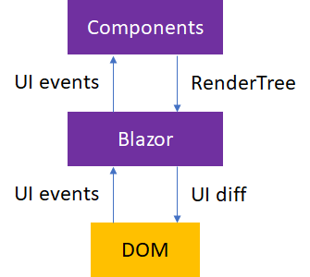
Blazor Server APPS
Reusable, retargetable UI component programming model
C#, HTML, and CSS plus async JavaScript interop when needed
Full C# .NET runtime stack
C# development platform (Visual Studio, Visual Studio Code, …)
Traditional server-based web application hosting model
Web UI is defined server side
Compiled server-side into highly compressed and efficient display list byte code
UI events and updates are exchanged over a highly optimized SignalR sockets protocol
SignalR is an open-source software library that allows server code to send asynchronous notifications to client-side web applications.
Run in any browser

Slide 12
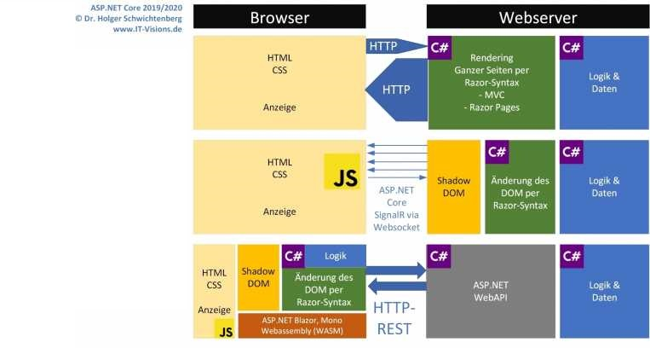
ARCHITECTURAL COMPARISON
ASP.NET CORE
BLAZOR SERVER
BLAZOR WASM

Slide 13
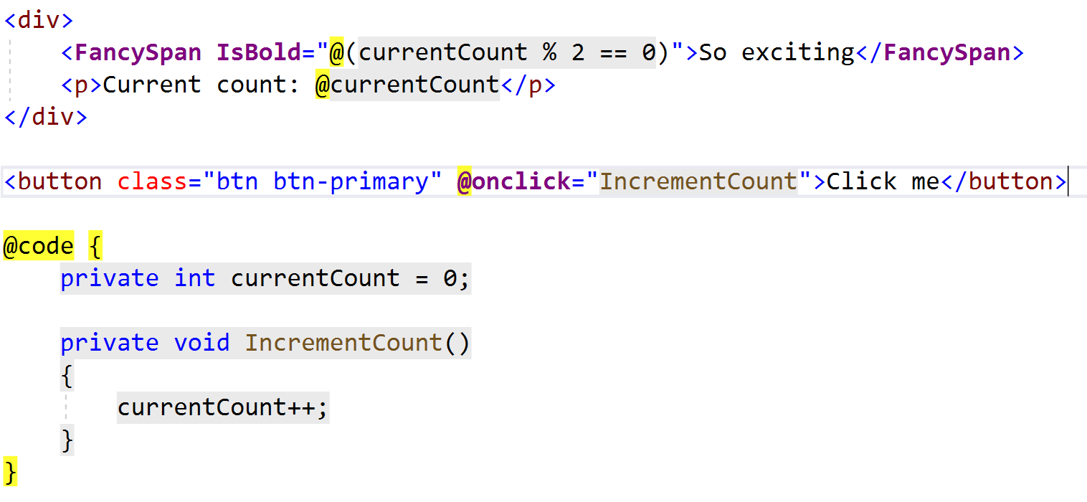
RenderTree (aka Shadow DOM) 1/3
Notes:
https://github.com/rynowak/Presentations/tree/master/2019/AusNzMeetups/blazor/code-snippets/Shared

Slide 14
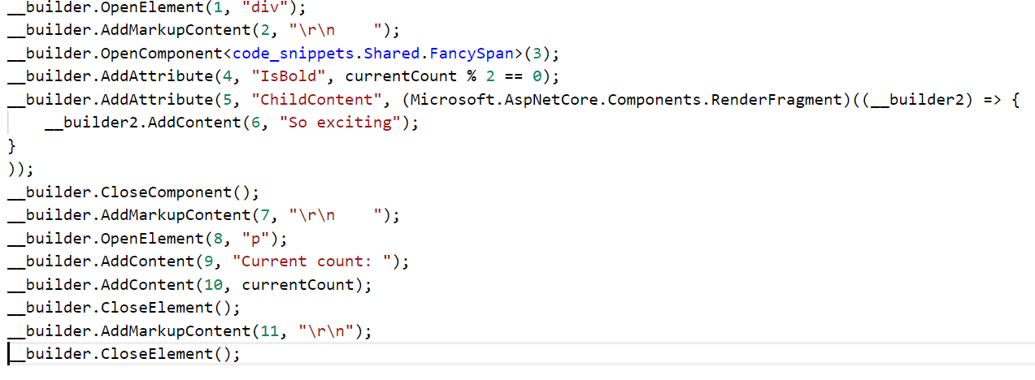
RenderTree (aka Shadow DOM) 2/3
Notes:
https://github.com/rynowak/Presentations/tree/master/2019/AusNzMeetups/blazor/code-snippets/Shared

Slide 15
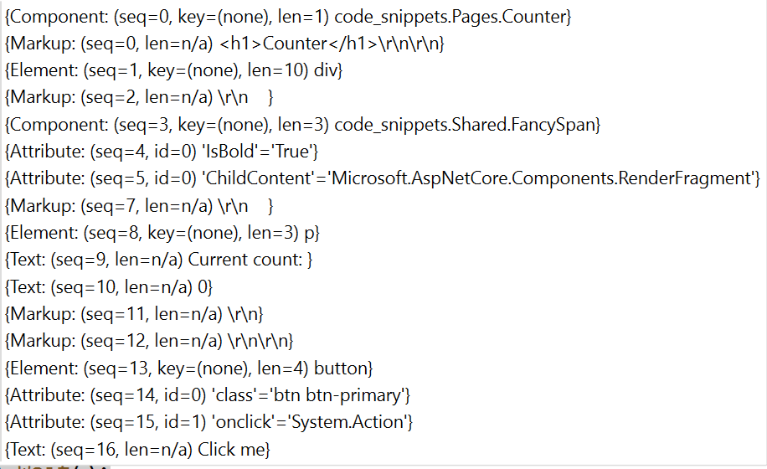
RenderTree (aka Shadow DOM) 3/3
Notes:
https://github.com/rynowak/Presentations/tree/master/2019/AusNzMeetups/blazor/code-snippets/Shared

Slide 16
DEMOS
Out-of-the-box Blazor Server App (Visual Studio 2019)
Blazor Component Model, Service Dependency Injection, C#/Visual Studio Integration
2020-11-23

Slide 17

 NEO4J Graph Database Server
CSharp Super Stack - Hyperonomy Digital Identity Lab - Parallelspace Corporation
2020-11-23

Slide 18
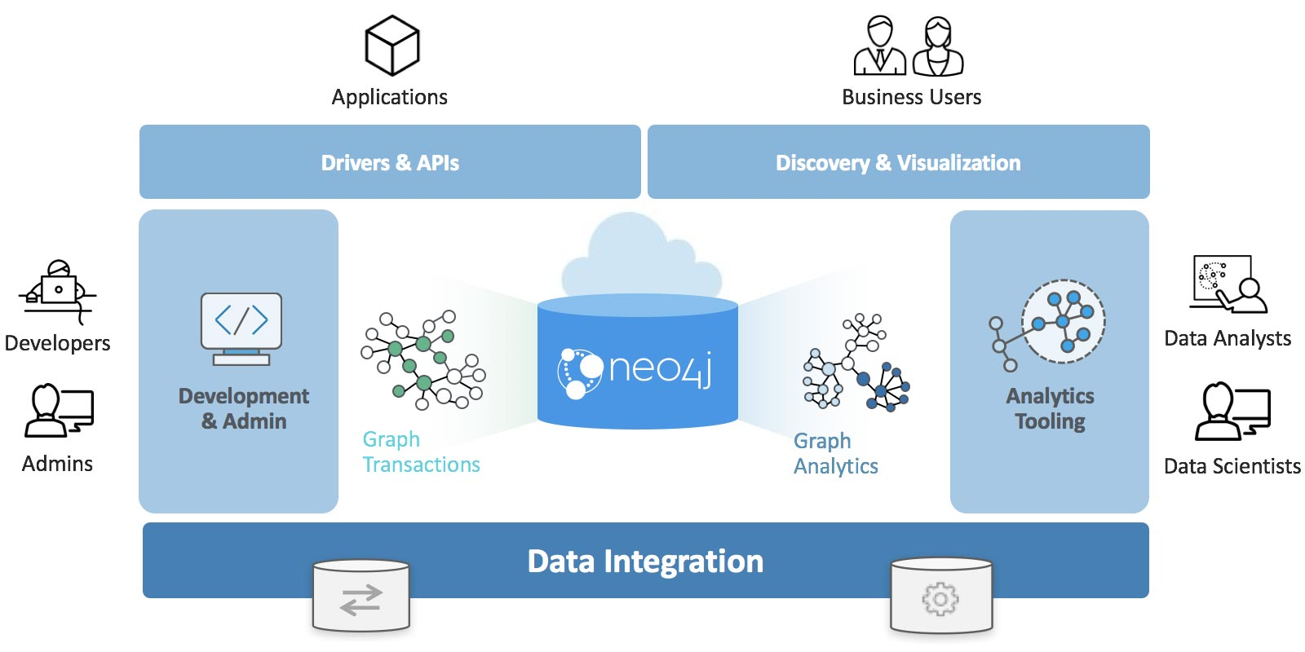
Neo4j Graph Database Platform

Slide 19
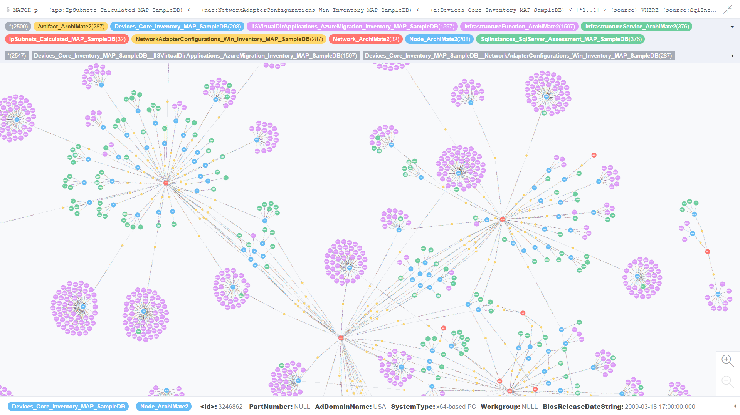

Slide 20
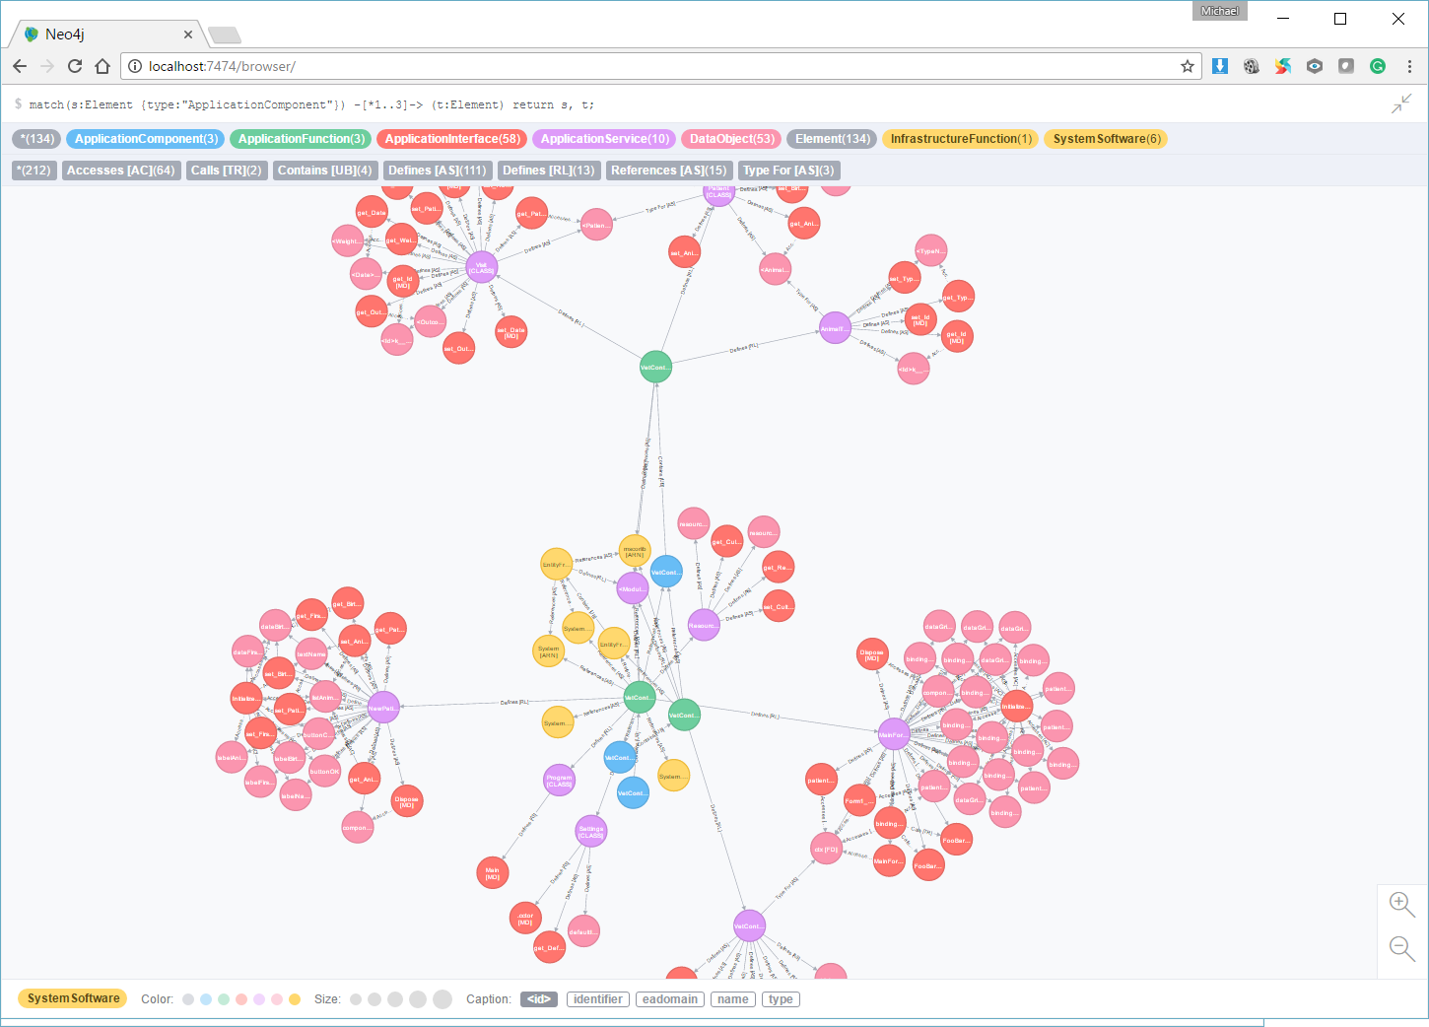
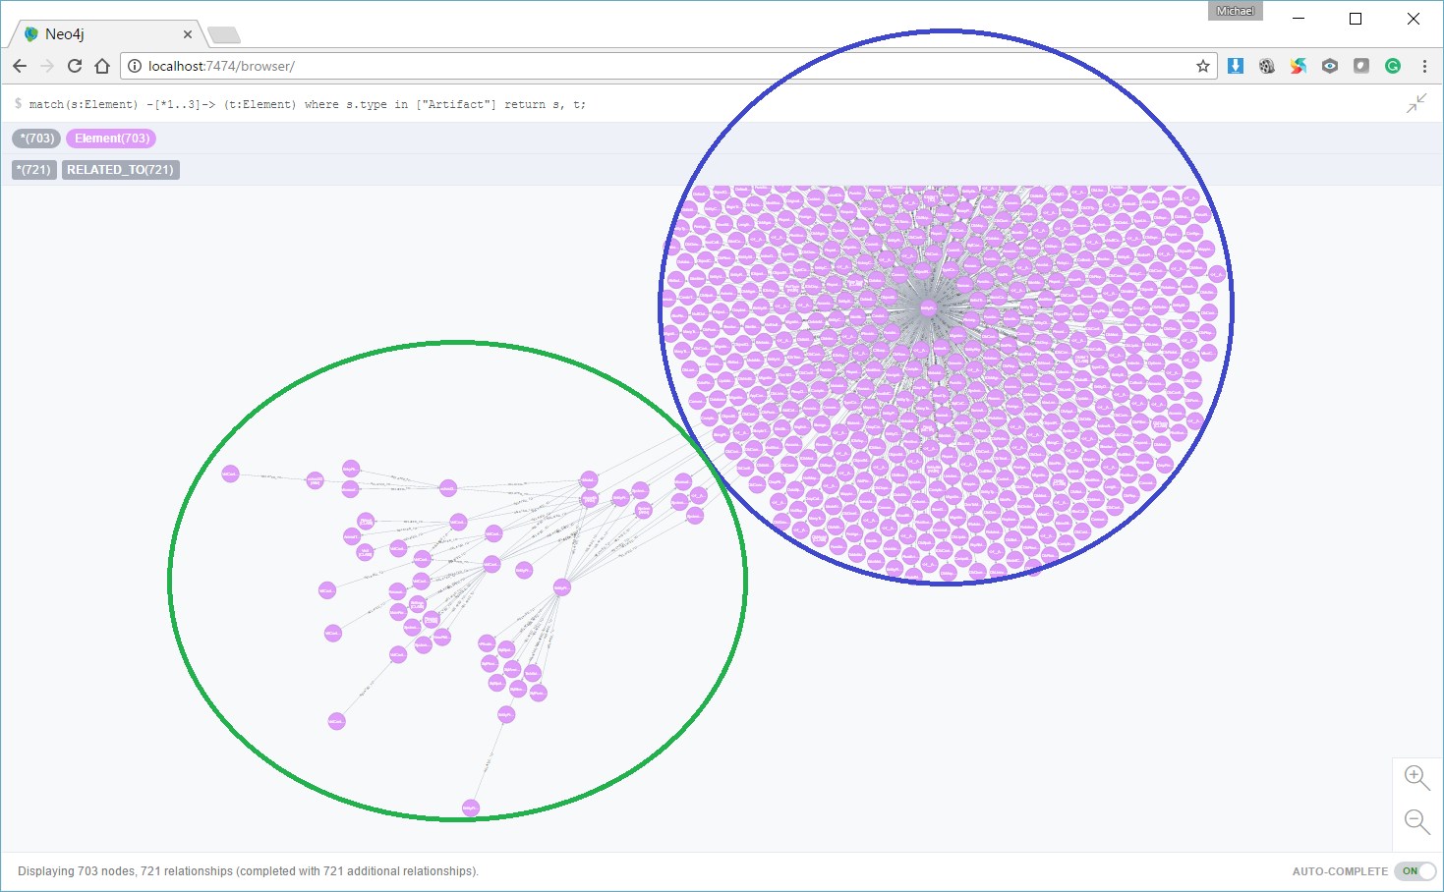

Slide 21
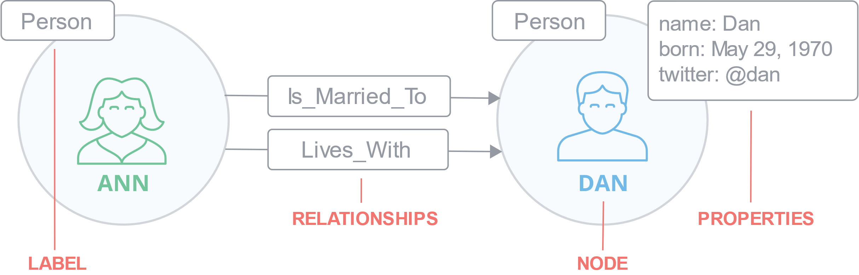
Neo4J: Labeled Property Graph Model
Notes:
Nodes
Nodes are the main data elements
Nodes are connected to other nodes via relationships
Nodes can have one or more properties (i.e., attributes stored as key/value pairs)
Nodes have one or more labels that describes its role in the graph
Example: Person nodes vs Car nodes
Relationships
Relationships connect two nodes
Relationships are directional
Nodes can have multiple, even recursive relationships
Relationships can have one or more properties (i.e., attributes stored as key/value pairs)
Properties
Properties are named values where the name (or key) is a string
Properties can be indexed and constrained
Composite indexes can be created from multiple properties
Labels
Labels are used to group nodes into sets
A node may have multiple labels
Labels are indexed to accelerate finding nodes in the graph
Native label indexes are optimized for speed

Slide 22
Neo4J: Labeled Property Graph Model
Nodes
Nodes are the main data elements
Nodes are connected to other nodes via relationships
Nodes can have one or more properties (i.e., attributes stored as key/value pairs)
Nodes have one or more labels that describes its role in the graph
Example: Person nodes vs Car nodes
Relationships
Relationships connect two nodes
Relationships are directional
Nodes can have multiple, even recursive relationships
Relationships can have one or more properties (i.e., attributes stored as key/value pairs)
Properties
Properties are named values where the name (or key) is a string
Properties can be indexed and constrained
Composite indexes can be created from multiple properties
Labels
Labels are used to group nodes into sets
A node may have multiple labels
Labels are indexed to accelerate finding nodes in the graph
Native label indexes are optimized for speed
CSharp Super Stack - Hyperonomy Digital Identity Lab - Parallelspace Corporation
2020-11-23

Slide 23
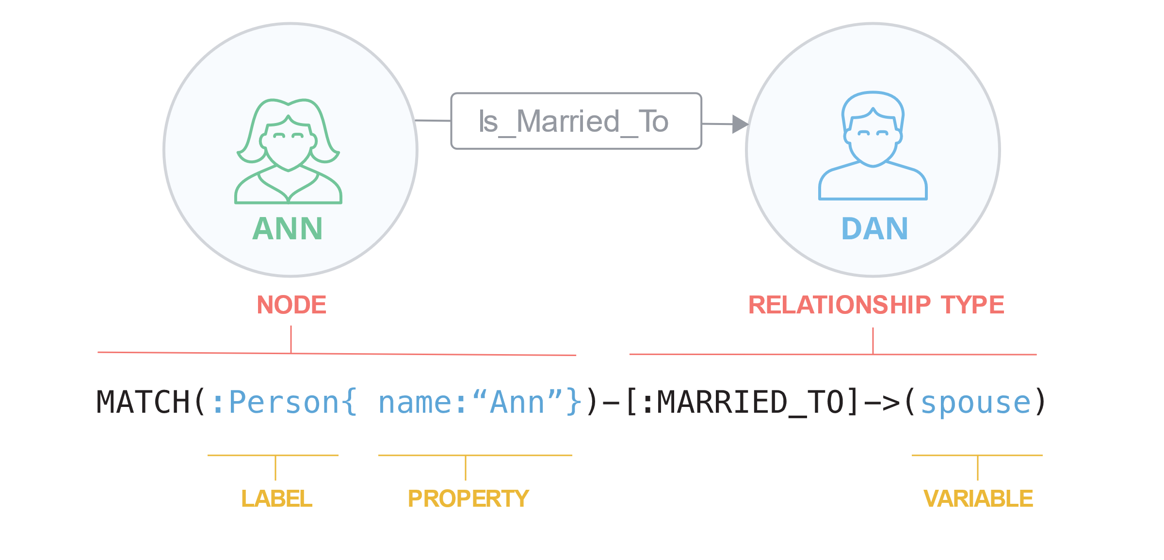
Cypher query Language
Notes:
Nodes
Nodes are the main data elements
Nodes are connected to other nodes via relationships
Nodes can have one or more properties (i.e., attributes stored as key/value pairs)
Nodes have one or more labels that describes its role in the graph
Example: Person nodes vs Car nodes
Relationships
Relationships connect two nodes
Relationships are directional
Nodes can have multiple, even recursive relationships
Relationships can have one or more properties (i.e., attributes stored as key/value pairs)
Properties
Properties are named values where the name (or key) is a string
Properties can be indexed and constrained
Composite indexes can be created from multiple properties
Labels
Labels are used to group nodes into sets
A node may have multiple labels
Labels are indexed to accelerate finding nodes in the graph
Native label indexes are optimized for speed

Slide 24
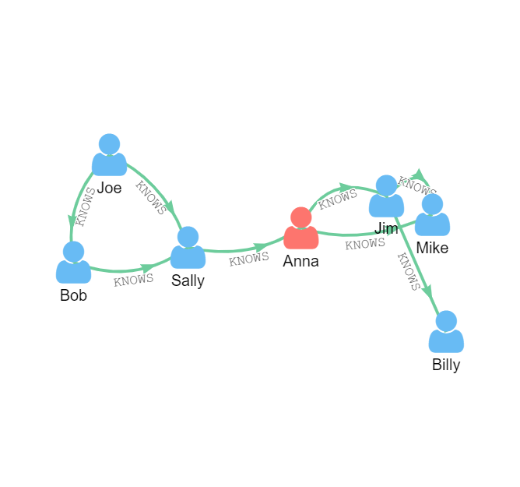
Cypher query Language 1/2
Notes:
Nodes
Nodes are the main data elements
Nodes are connected to other nodes via relationships
Nodes can have one or more properties (i.e., attributes stored as key/value pairs)
Nodes have one or more labels that describes its role in the graph
Example: Person nodes vs Car nodes
Relationships
Relationships connect two nodes
Relationships are directional
Nodes can have multiple, even recursive relationships
Relationships can have one or more properties (i.e., attributes stored as key/value pairs)
Properties
Properties are named values where the name (or key) is a string
Properties can be indexed and constrained
Composite indexes can be created from multiple properties
Labels
Labels are used to group nodes into sets
A node may have multiple labels
Labels are indexed to accelerate finding nodes in the graph
Native label indexes are optimized for speed

Slide 25
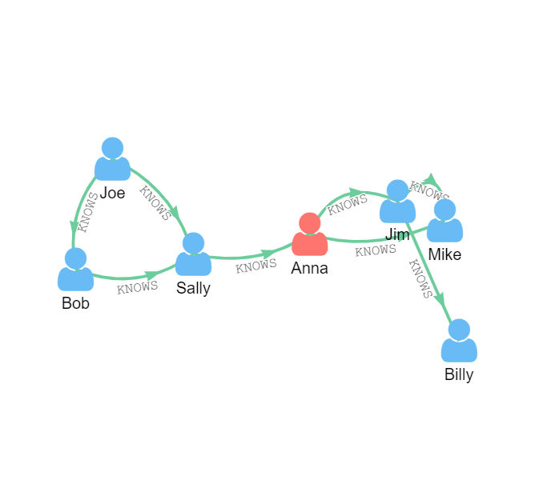
Cypher query Language 2/2
Find Friends of Friends
MATCH
(person:Person)-[:KNOWS]-(friend:Person)-[:KNOWS]-
(friendoffriend:Person)
WHERE
person.name = "Joe"
AND NOT (person)-[:KNOWS]-(friendoffriend)
RETURN
friendoffriend

Slide 26
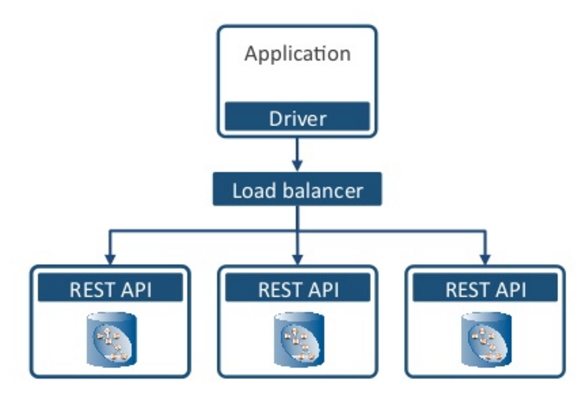
Neo4j Deployment Model

Slide 27
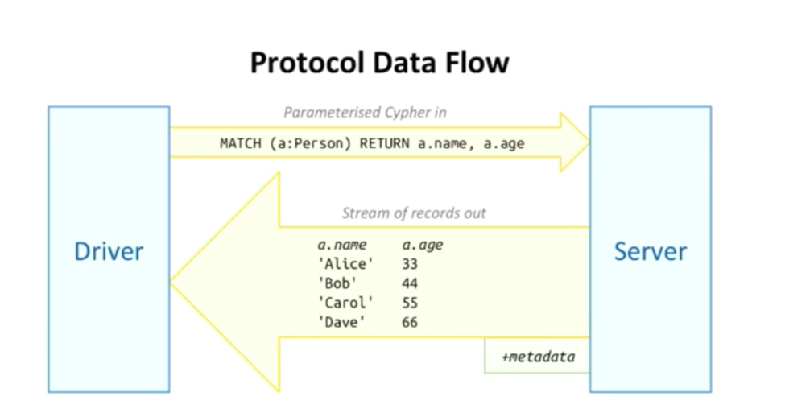
NEO4j Server Protocol

Slide 28

 Neo4j .NET Integration
CSharp Super Stack - Hyperonomy Digital Identity Lab - Parallelspace Corporation
2020-11-23

Slide 29
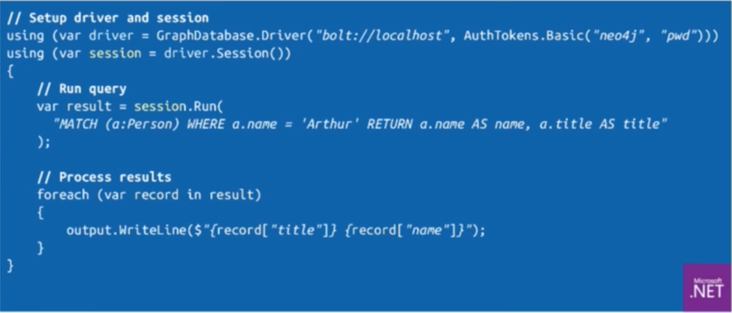
NEO4J .NET Driver
Glue for .NET apps wanting to talk to a Neo4j graph server

Slide 30
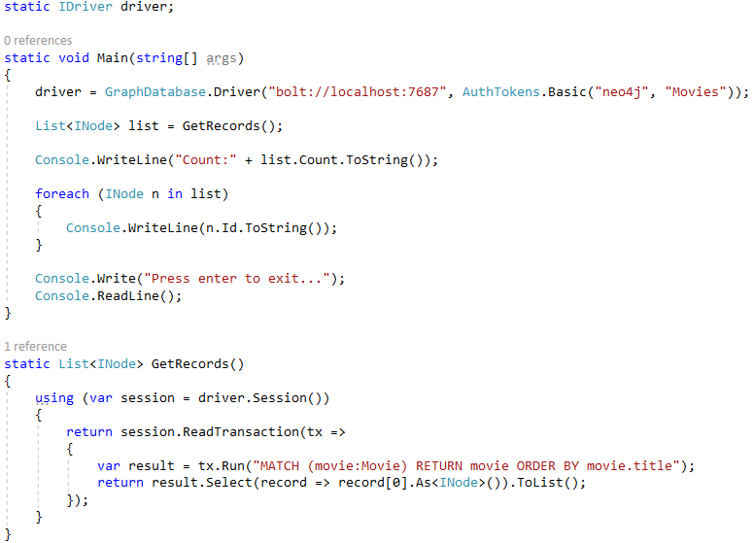
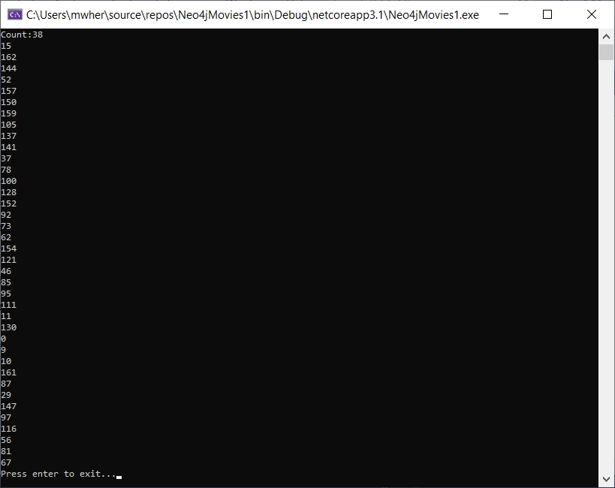
MOVIES: Windows CONSOLE APP

Slide 31
Neo4J .NET Driver Query Methods
public Query(string text, object parameters)
: this(text, parameters.ToDictionary())
{
}
public Query(string text, IDictionary<string, object> parameters)
{
Text = text;
Parameters = parameters ?? new Dictionary<string, object>();
}
Notes:
https://github.com/neo4j/neo4j-dotnet-driver/blob/4.2/Neo4j.Driver/Neo4j.Driver/Query.cs#L47

Slide 32
TODO

Slide 33

 CSharp Super Stack (CSSS)
Bringing it all together
CSharp Super Stack - Hyperonomy Digital Identity Lab - Parallelspace Corporation
2020-11-23

Slide 34
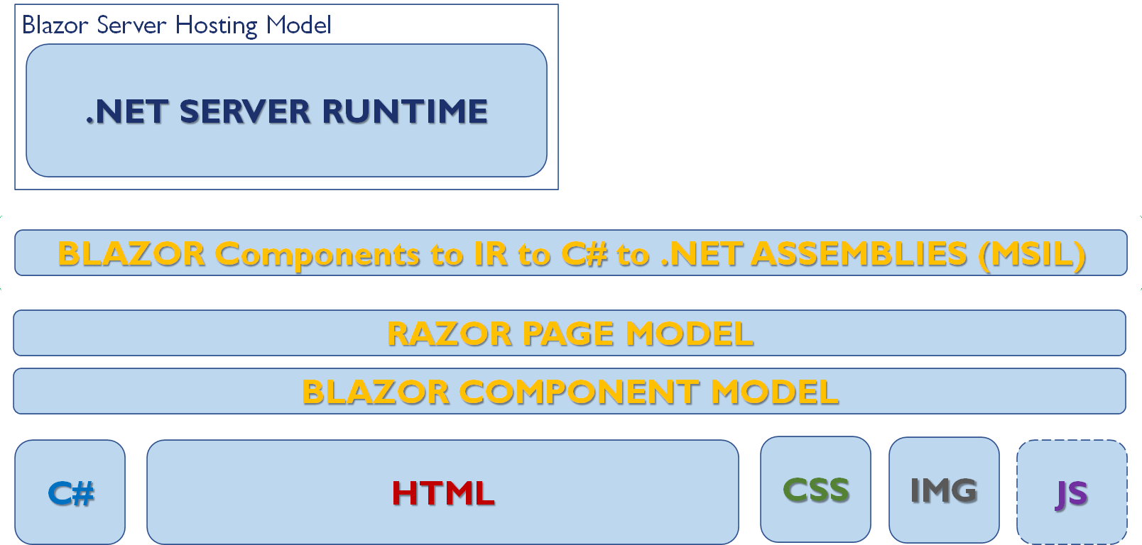
CSharp Super Stack (CSSS)
Blazor Component C# Code
Neo4jMovieService C# Code
Parallelspace.CSharpSuperStack. Neo4jEntities (“Wrapper”)
BlazorServerAppMovies4
Neo4j .NET Driver
Neo4j Server (“Movies”)

Slide 35
Blazor Component Methods
void AddMovieShow()
void EditMovieShow(Neo4j.Driver.INode movie)
async Task GetMovies()
async Task SaveMovieUpdate()
async Task DeleteMovieUpdate()

Slide 36
Neo4JMovieService Service
Task<INode[]> GetMoviesAsync()
Task MergeMovieAsync(Movie movie)
Task DeleteMovieAsync(Movie movie)

Slide 37
Csharp Super Stack (CSSS) .NET Driver WRAPPER
List<INode> Query(string filterlabel, Dictionary<string, object> filterprops)
List<INode> Create(string label, Dictionary<string, object> properties)
List<INode> Update(string label, Dictionary<string, object> properties)
string Delete(string id)

Slide 38
DEMOS
Blazor “Movies”
CSharp Super Stack “Movies”

Slide 39
 Final Notes
CSharp Super Stack - Hyperonomy Digital Identity Lab - Parallelspace Corporation
2020-11-23

Slide 40
Scalability
2500 connected Blazor client browsers: ~1.5 GB of memory on the server
https://habr.com/en/company/microsoft/blog/473146/
Single Standard_D1_v2 instance on Azure (1 vCPU, 3.5 GB memory) could handle over 5,000 concurrent users without any degradation in latency.
A Standard_D3_V2 instance (4 vCPU, 14GB memory) handled well over 20,000 concurrent clients. The main bottleneck for handling further load was available memory.
ASP.NET Core Perf Testing
About 250kb of memory used per client
Small VM (D1_V2) handled 5000 concurrent clients with no degradation
Large VM (D3_V2) handled 20000 concurrent clients with no degradation
Main factor is memory consumption and GC
Notes:
https://youtu.be/dCgqTDki-VM?t=1743

Slide 41
RESOURCES
Avoid Blazor resources dated older than 2020
Blazor
Getting Started with Blazor (http://blazor.net)
Blazor OSS Project (https://github.com/dotnet/aspnetcore/tree/master/src/Components)
Blazor Documentation (https://docs.microsoft.com/en-us/aspnet/core/blazor/?view=aspnetcore-5.0)
Using MVC with Blazor Components (https://www.youtube.com/watch?v=MetcuX1OHD0)
Blazor eBook (free) (https://devblogs.microsoft.com/aspnet/blazor-aspnet-webforms-ebook/)
ASP.NET Blog (https://devblogs.microsoft.com/aspnet/category/blazor/)
Neo4j
Neo4j Developer Resources (https://neo4j.com/developer/dotnet/)
Multiple programming language examples (https://neo4j.com/developer/#cs-1)
CSharp Super Stack
GitHub (https://github.com/mwherman2000/CSharpSuperStack)
Other Resources
Awesome Blazor (https://github.com/AdrienTorris/awesome-blazor)

Slide 42
 Questions?
Michael Herman Hyperonomy Digital Identity Lab Parallelspace Corporation Alberta, CANADA
mwherman@parallelspace.net
CSharp Super Stack - Hyperonomy Digital Identity Lab - Parallelspace Corporation
2020-11-23

Slide 43
 Backup Slides
CSharp Super Stack - Hyperonomy Digital Identity Lab - Parallelspace Corporation
2020-11-23

Slide 44

C#
CSS
HTML

Slide 45

C#
CSS
HTML

